Slide 1



Slide 2
Modern AI-infused applications for financial markets
ISV203
Arseni Yustus (he/him)
Anton Antonov (he/him)
Solutions Architect
Amazon Web Services
Head of AI and Quantitative Research
dxFeed Solutions DE GmbH

Slide 3
IT Evolution
Internet Era
Web Era
Cloud Era
AI & Data Era
1990-2000s
2000-2010s
2010-2020s
2020-2025s
World Wide Web
TCP/IP protocol
Web browsers
Static HTML pages
Email systems
Basic e-commerce
Dial-up internet
Domain Name System
Web 2.0
Generated content
Social medias
Mobile internet
Mobile applications
CMS and blogging
Online gaming
Web-based services
Video streaming
Cloud computing
Software as a Service
Mobile Computing
Big Data analytics
API economy
Serverless computing
Infrastructure as Code
Microservices
Containers
Internet of Things
Machine Learning
Generative AI
Large Language Models (LLMs)
Deep learning
Retrieval-Augmented Generation (RAG)
Voice assistants
AutoML
Data Lakes
Computer vision
Image recognition
Blockchain
Data mesh
GPU acceleration
Notes:
Consistent Bullet Point Structure for "Evolution of IT"
Recommended Structure: [Category] - [Specific Technology/Platform]
INTERNET ERA (1990-2000s) • Networking - TCP/IP protocol standardization • Web Foundation - World Wide Web (HTTP/HTML) • Browsers - Web browsers (Netscape, Internet Explorer) • Content - Static HTML pages and websites • Communication - Email systems and protocols • Commerce - Basic e-commerce platforms • Connectivity - Dial-up internet and ISPs • Infrastructure - Domain Name System (DNS)
WEB ERA (2000-2010s) • Web Evolution - Web 2.0 and user-generated content • Social Platforms - Social media networks • Mobile Access - Mobile internet and WAP • Applications - Mobile applications and app stores • Content Management - CMS and blogging platforms • Entertainment - Online gaming and digital media • Services - Web-based services and APIs • Streaming - Video streaming platforms
CLOUD ERA (2010-2020s) • Infrastructure - Cloud computing (IaaS, PaaS, SaaS) • Development - Software as a Service platforms • Mobile Computing - Mobile-first applications • Analytics - Big Data analytics and processing • Integration - API economy and microservices • Automation - Serverless computing and auto-scaling • DevOps - Infrastructure as Code and CI/CD • Architecture - Microservices and containerization • Containers - Docker and Kubernetes orchestration • Connectivity - Internet of Things (IoT) devices
AI & DATA ERA (2020-2025s) • Machine Learning - ML algorithms and frameworks • AI Models - Generative AI and large language models • Deep Learning - Neural networks and deep learning • Language Models - Large Language Models (LLMs) • Information Retrieval - RAG (Retrieval-Augmented Generation) • Operations - MLOps and model lifecycle management • Interfaces - Voice assistants and conversational AI • Automation - AutoML and automated model training • Storage - Data lakes and data warehouses • Vision - Computer vision and image recognition • Distributed Ledger - Blockchain and decentralized systems • Data Architecture - Data mesh and modern data stack • Computing - GPU acceleration and parallel processing
AGENTIC AI ERA (2025-Present) • Autonomous Systems - Autonomous AI agents and decision-making • Multi-Agent - Multi-agent systems and coordination • Data Processing - Multi-modal data integration and analysis • AI Reasoning - Advanced reasoning chains and logic • Decision Making - Autonomous decision-making systems • Orchestration - LLM orchestration and workflow automation • Edge Computing - Edge AI and distributed intelligence • Platforms - AI orchestration and management platforms • Advanced Computing - Quantum-AI hybrid systems and neuromorphic computing

Slide 4
IT Evolution
Internet Era
Web Era
Cloud Era
AI&Data Era
Agentic AI Era
1990-2000s
2000-2010s
2010-2020s
2020-2025s
2025-Present
• Autonomous Systems
• Multi-agent systems and coordination
• Multi-modal data integration and analysis
• Advanced reasoning chains and logic
• Autonomous decision-making systems
• LLM orchestration and workflow automation
• Edge Computing
• AI orchestration and management platforms
• Quantum-AI hybrid systems
Notes:
Autonomous Systems - Autonomous AI agents and decision-making
Multi-Agent - Multi-agent systems and coordination
Data Processing - Multi-modal data integration and analysis
AI Reasoning - Advanced reasoning chains and logic
Decision Making - Autonomous decision-making systems
Orchestration - LLM orchestration and workflow automation
Edge Computing - Edge AI and distributed intelligence
Platforms - AI orchestration and management platforms
Advanced Computing - Quantum-AI hybrid systems and neuromorphic computing

Slide 5
What are AI Agents?
Autonomous software systems that leverage AI to reason, plan, and complete tasks on behalf of humans or systems
Notes:
At AWS, we define AI agents as are autonomous software systems that leverage AI to reason, plan, and complete tasks on behalf of humans or systems – like compiling research, paying bills, planning a trip or managing enterprise applications.
What makes agents powerful is their ability to think iteratively - to evaluate results, adjust their approach, and continue working toward a goal. They don't just answer questions; they solve problems through a process of exploration and refinement.

Slide 6
Why Agentic AI?
Autonomous software systems
Ability to think iteratively
Solve real-world problems
Notes:
Autonomous navigation through complex real-world scenarios
Connectivity with the world via APIs and data
Ability to think iteratively (agent loop, autonomous operation)
Memory

Slide 7
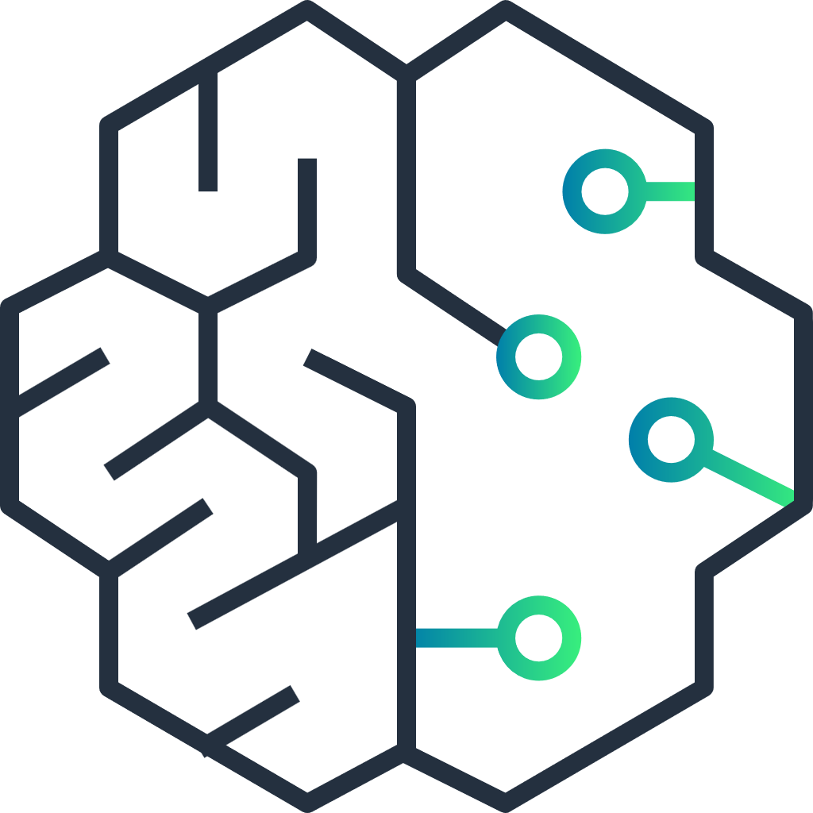






How AI Agents Work
Planning
Tools
Reflection
Chain of Thoughts
Self-Critics
Subgoal Decomposition
Search
Prompt
API
Response
User/Service
AI Agent
LLM
Actions
Database
Analyze
Calculator
Memory
Trained dataset
Short-term
Long-term
Calendar

Slide 8
Agentic AI will Transform the Enterprise
AI Agents will drive performance gains, better problem solving and faster time to action
50%
40%
33%
Organizations will use agents to achieve business value from AI by 2025
Improvements in cycle times, with improved quality, with AI agents
Of enterprise software applications will include agentic AI by 2028

Slide 9
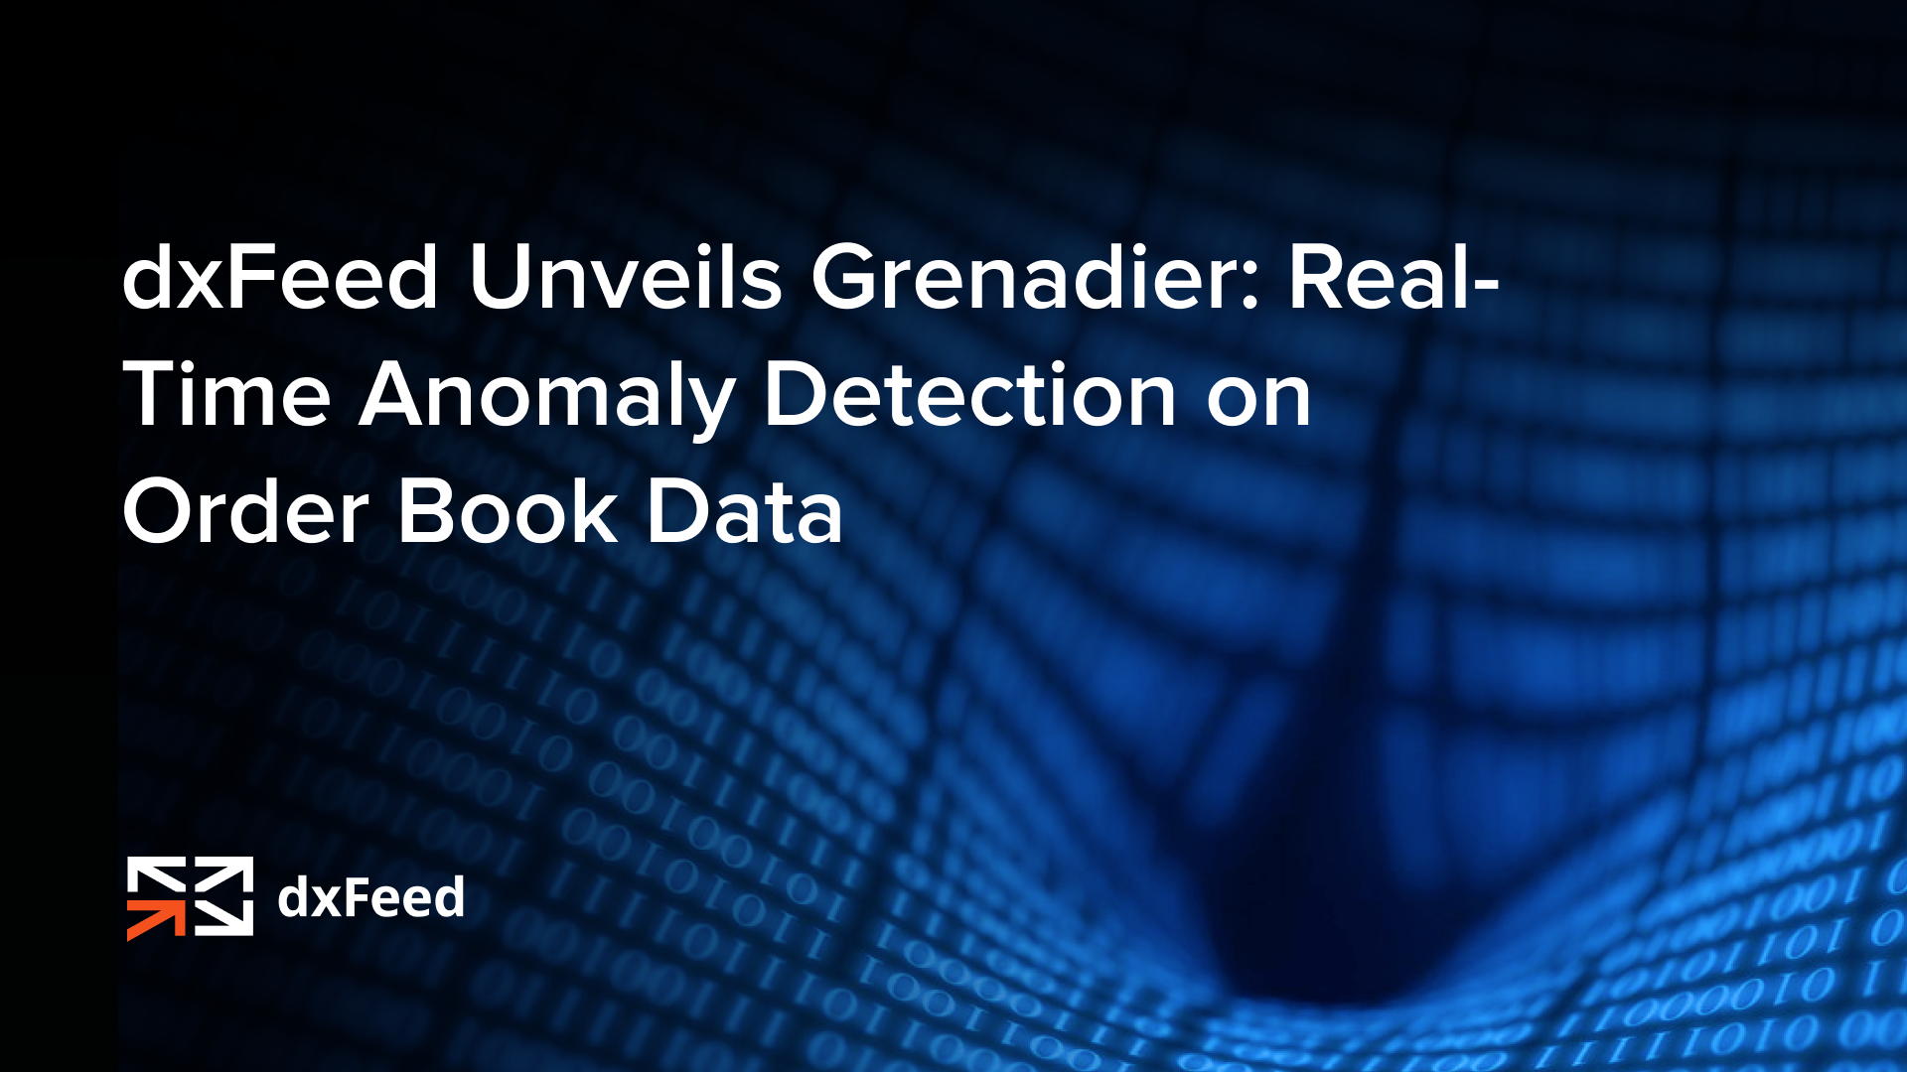
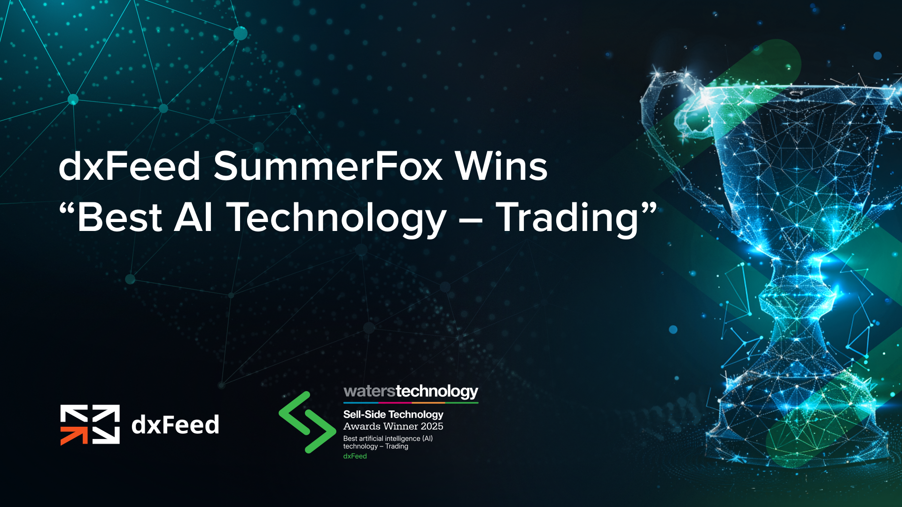
Using Agents in financial markets

Slide 10
The AI Market Analysis Challenge
Unique demands of financial markets:
Real-time processing requirements
Low tolerance for errors
Multiple, often conflicting data sources
Complex interdependencies between data points

Slide 11
The AI Market Analysis Challenge
Common pitfalls of AI implementation
Over-reliance on black-box models
Insufficient data validation
Poor integration with existing systems
Neglecting calculation accuracy

Slide 12


The AI Market Analysis Challenge
What is the square root of 66,777,278,569?
Llama-3.3-70B
258,275
DeepSeek-V3
258,387
258,413

Slide 13
The AI Market Analysis Challenge
What is the highest stock price of AMZN on 22 Aug 2023?
Cannot answer
What is the company under ticker “PERF”?
Perfumania Holdings

Slide 14
The AI Market Analysis Challenge
What is the highest stock price of AMZN on 22 Aug 2023?
$137.98 per share
What is the company under ticker “PERF”?
Perficient, Inc.

Slide 15

The AI Market Analysis Challenge
What is the highest stock price of AMZN on 22 Aug 2023?
$135.65 per share
What is the company under ticker “PERF”?
Perfect Corp
(class A shares, listed on NYSE)

Slide 16



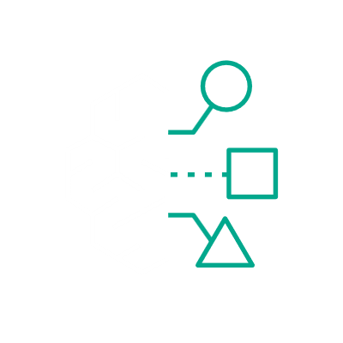


Agentic Architecture via MCP
Model Context Protocol (MCP): an open-source standard for connecting AI applications to external systems
...like a USB-C port for AI applications
Data quality guarantee
Access to specialized calculation engines
Enhanced security and compliance
Real-time data extraction
Benefits for financial markets

Slide 17
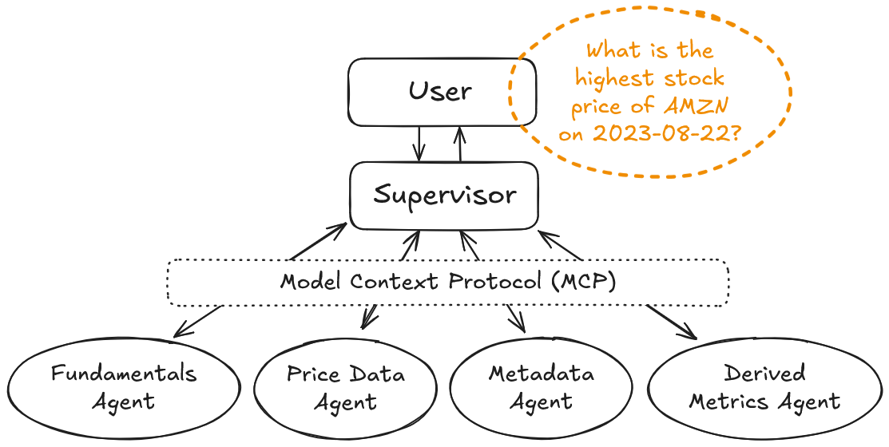

Slide 18
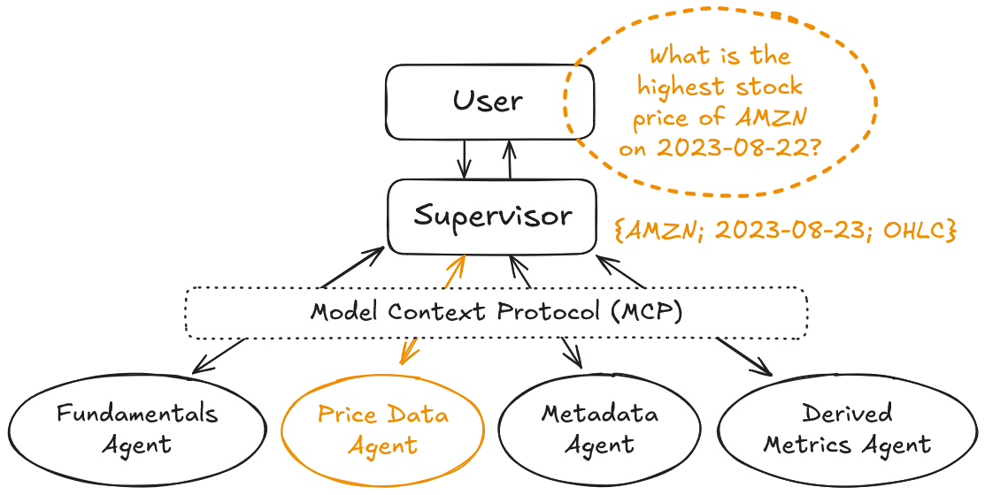

Slide 19
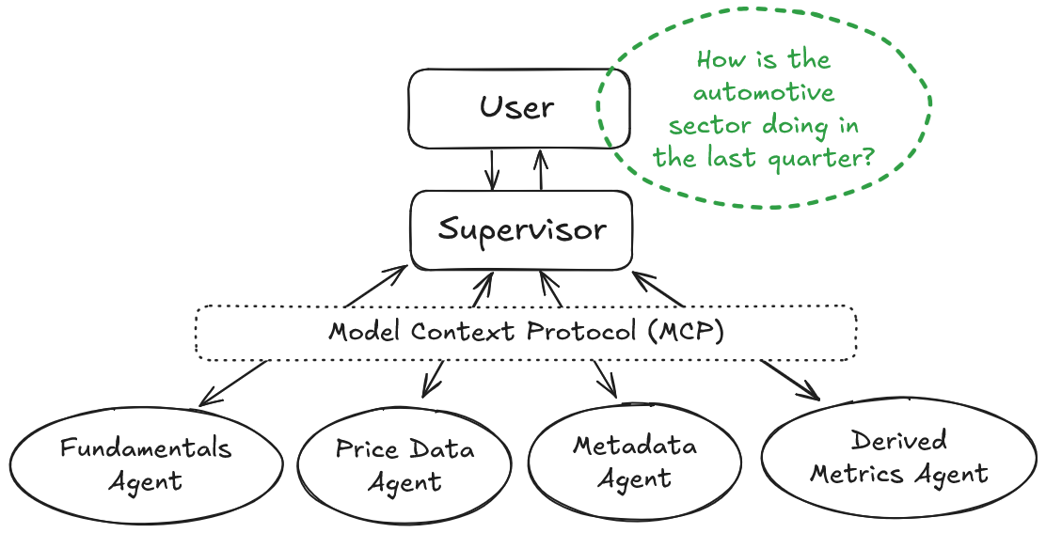

Slide 20
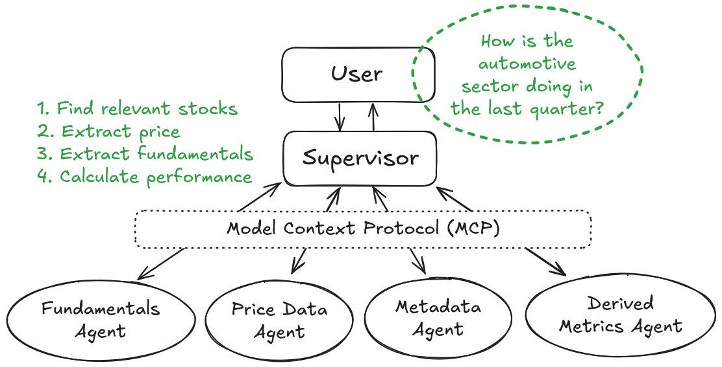

Slide 21
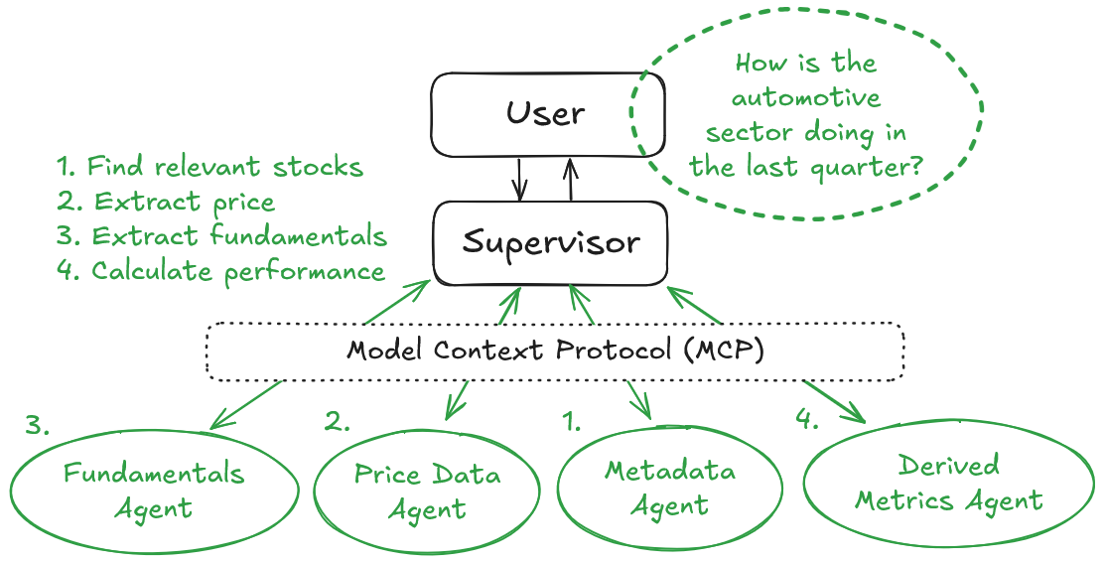

Slide 22




SummerFox code
Docker file
Amazon EC2
AWS Bedrock
Data Lake
Agent
Agent
Agent
User
MCP Client
News
Fundamentals
Agent
Agent
Agent
Charting Server
Instrument Metadata

Slide 23

SummerFox code
Docker file
AWS Bedrock
Amazon Bedrock AgentCore
Data Lake
Agent
Agent
Agent
User
MCP Client
News
Fundamentals
Agent
Agent
Agent
Charting Server
Instrument Metadata

Slide 24
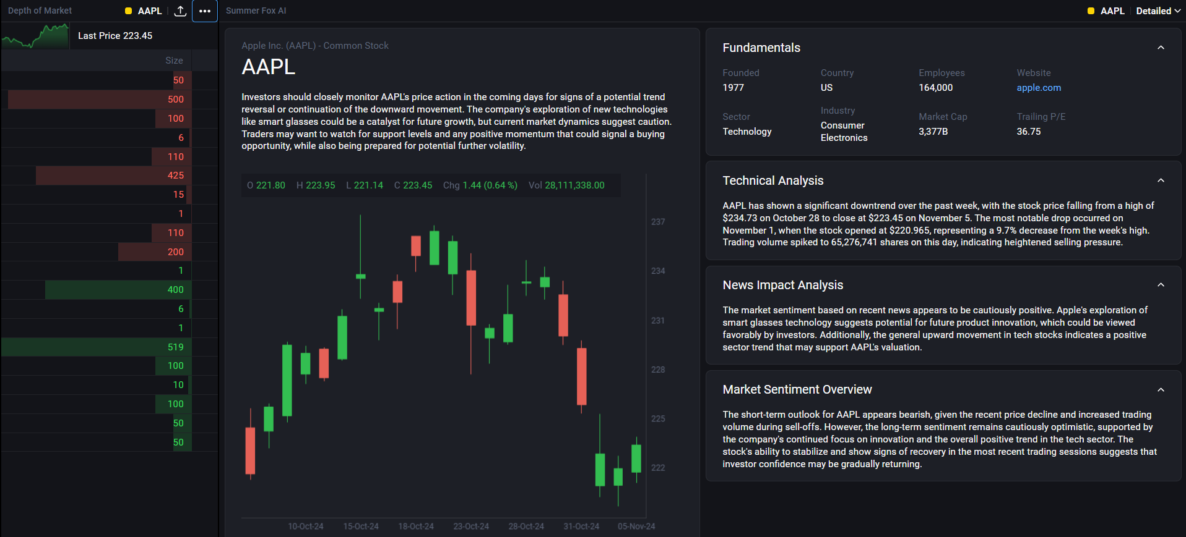
dxFeed SummerFox in Action
What is the high-level outlook?
What data-driven insights are there?
How do recent news affect the stock?
What is the current market consensus?

Slide 25
Implementation Considerations
Prompt Engineering Techniques
Be specific
Provide few-shot response examples
Establish specific guardrails
Know the weak points of an LLM
Reinforce capabilities with access to tools and agents
Guidelines for Production
Enable prompt/response caching
Implement tracing (Langsmith)
Have multiple independent LLM vendors (AWS Bedrock, AgentCore)
Quality control (Deepeval)

Slide 26
Evals: What and Why to Measure
Factual correctness
Contextual relevance
At new builds & releases
Hallucination rates
For switchover to new models
Alignment / bias
Adherence to guardrails
As early signs of model degradation
Toxicity

Slide 27
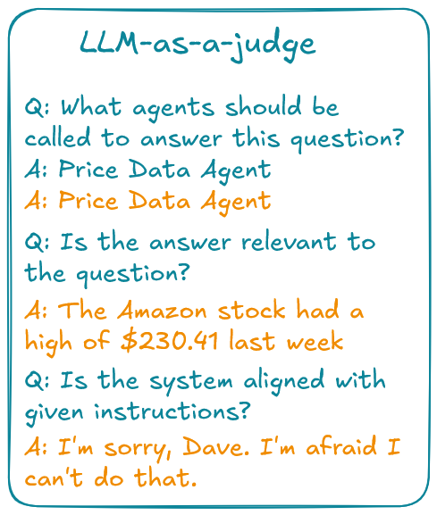


Evals
What is the point validating LLM with itself?
Not with itself, but with a bigger & better model!

Slide 28
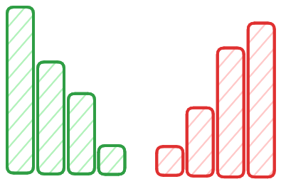
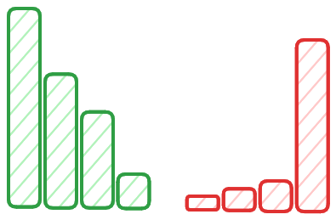
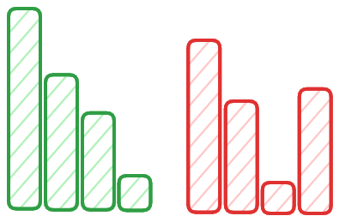
Anomaly Detection Challenge: In-house Models
The needle in the haystack problem: rare and fuzzily defined events
Rule-based or feature engineered conditions:
must be manually constructed or selected
must be calibrated and recalibrated, may get outdated quickly

Slide 29
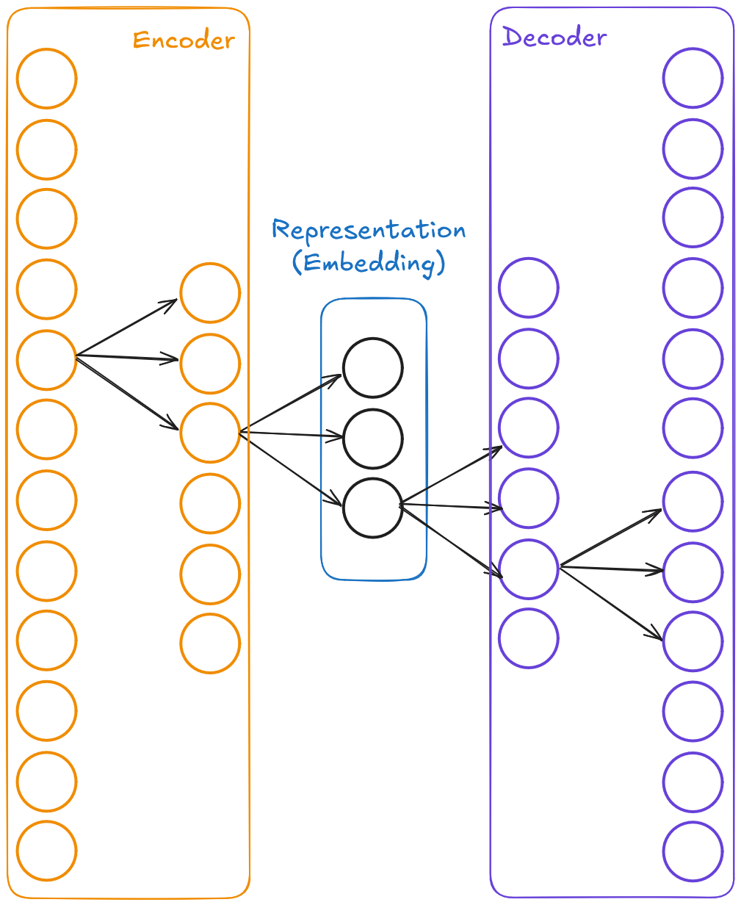
Anomaly Detection Challenge: In-house Models
Our training setup:
Order book snapshots sourced from dxFeed Data Lake
Autoencoder architecture
Full control over the neural net parameters and weights
Reconstruction quality is what defines anomalies

Slide 30
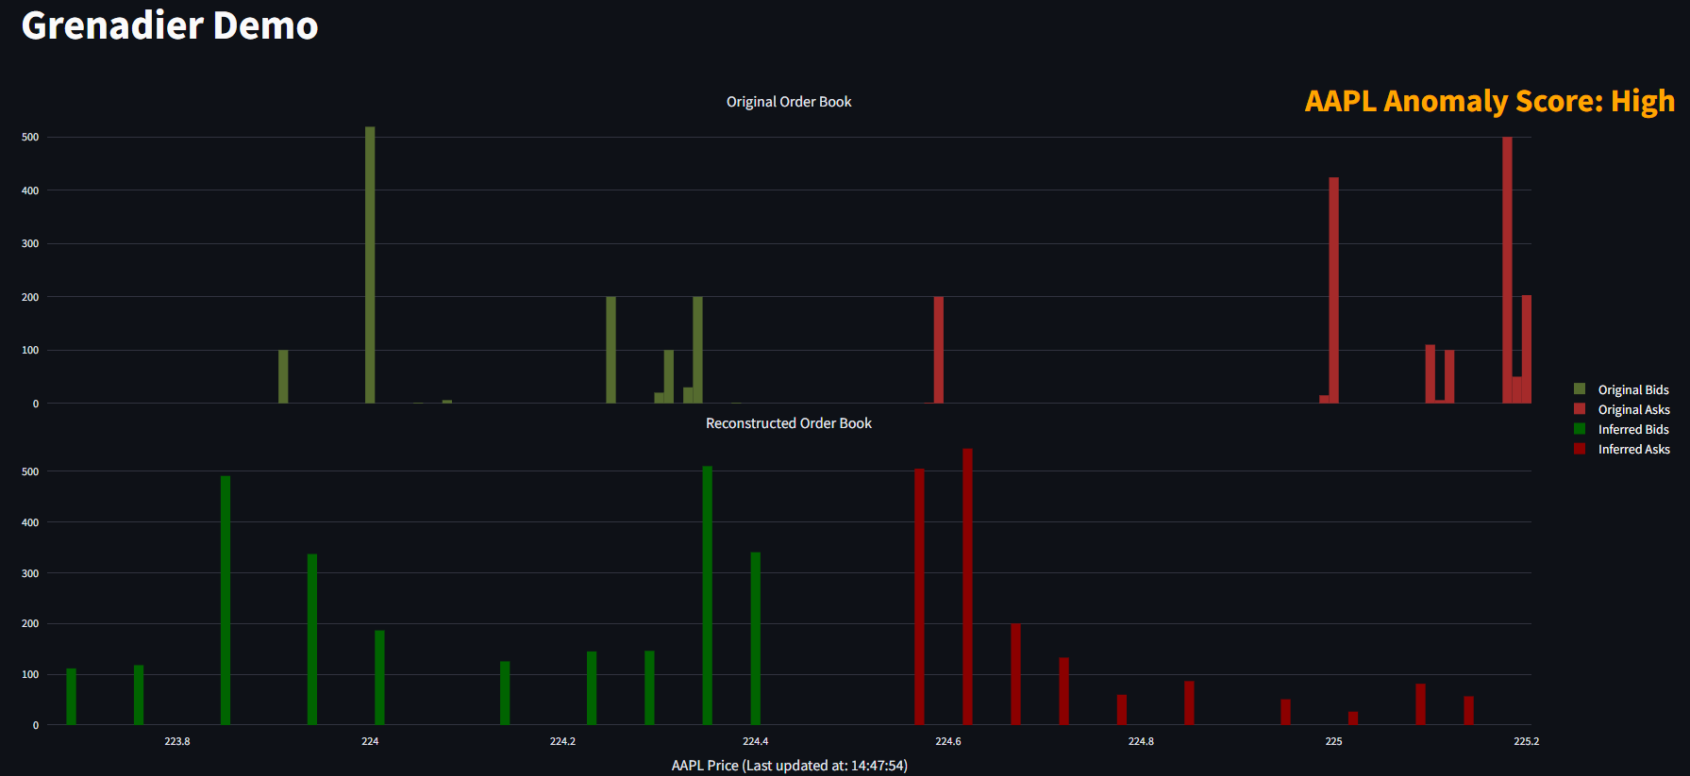
dxFeed Grenadier in Action
Large volume concentration far from the spread
Anomaly-free state of the order book

Slide 31
Key Takeaways
AI in finance requires approaches beyond generic LLMs
Model Context Protocol enables controllable knowledge extraction in agentic architectures
Output quality is secured via:
Data layers and calculation engines
Critic models and specialized evals
Full control over the training cycle for in-house models

Slide 32

dxFeed SummerFox: AI-driven market reporting
https://dxfeed.com/solutions/summerfox-market-intelligence-plus-ai/

Slide 33

dxFeed Grenadier: L2-based anomaly detection
https://dxfeed.com/solutions/dxfeed-grenadier/

Slide 34





Thank you!
Arseni Yustus
Anton Antonov
ayustus@amazon.com
antonov@dxfeed.com

